Slide 1
Macro outlook through 2070
Mark Pearson – WHO Europe

Slide 2
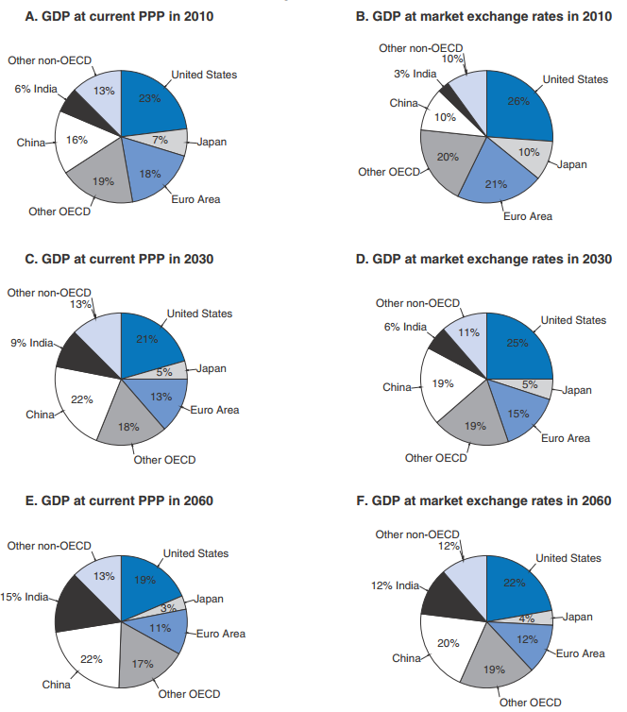
Rise of emerging economies
The composition of global output will continue to shift towards emerging economies.
The combined GDP of China and India was 33% of the OECD in 2010 (on a PPP basis), but is expected to rise to 73% by 2060.
Notes:
Economic Outlook May 2014 http://dx.doi.org/10.1787/888933050085

Slide 3
Emerging will outpace European economies in growth through 2060
Notes:
The OECD projects that European and OECD countries will continue to grow, but will be far outpaced by emerging economies through 2060. Emerging economies will eventually see their growth slow, and will begin to converge with OECD/Euro countries towards 2060.
Economic Outlook May 2014 http://dx.doi.org/10.1787/888933051700

Slide 4
In European countries, GDP growth will stabilize at around 1.5%
Notes:
Providing growth of the tech frontier at historical rates, average growth in OECD GDP per capita over the period through 2060 is projected to be the 1.5 % per year experience pre-crisis.

Slide 5
Historical substantial incomes gains across cohorts are falling off
Notes:
The slowdown in growth helped contribute to the slowdown in income gains across cohorts. PAU 2017

Slide 6
Several “mega-trends” are emerging in our economies
Technology is changing the workplace
Estimated worldwide annual supply of industrial robots
Populations are ageing
Old-age dependency ratio 65+/(15-64)
OECD average
The world has become more integrated
Share of business sector jobs sustained by consumers in foreign markets

Slide 7
Inequality on the rise…
Gini coefficients of income inequality, mid-1980s and 2013, or latest date available
Notes:
This may have an effect on acceptability of public spending and redistribution

Slide 8
…in part due to the decline in middle-skill jobs
"Heterogeneity in polarisation, selected OECD countries by region, 1995 to 2015 Percentage point change in share of total employment"

Slide 9
The old-age dependency ratio will almost double in the next 35 years…
Number of people older than 65 years per 100 people of working-age (20-64), 1980-2050
Notes:
That last trend will have a significant impact on health systems – partly because, as the next slide will emphasize, health worsens with age.

Slide 10
… which will have an impact on health systems
Share of people reporting bad health by age, gender, and education
Men
Women
Notes:
The number of people reporting bad health increases with age for both men and women, and at all levels of education.
Note: “Low”, “medium” and “high” levels of education correspond to International Standard Classification of Education (ISCED) codes 0 2, 3 4, and 5 6, respectively.
Source: OECD calculations from microdata on 24 OECD countries.

Slide 11
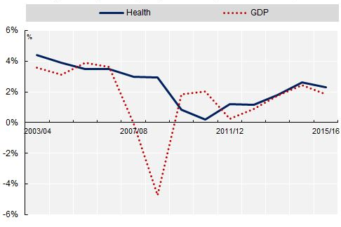
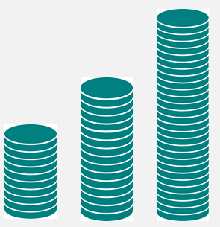
Health spending will continue to rise
Average OECD health spending and GDP growth
2008 economic crisis affected health spending in the short term …
Public health spending as % of GDP without effective cost containment
14%
… but medium to long-term projections point to continued growth
What are the options?
9%
6%
2010
2030
2060
Based on: OECD De La Maisonneuve & Oliveira Martins, 2013

Slide 12
But the uncertainty is huge …
Health care expenditure
Demography
Income
Residual
Only a minor effect since it is not ageing per se that creates expenditure pressures…
… and only an income elasticity of 1.8 could explain most of the expenditure growth in the OECD
… leaving nearly half that is unexplained … health prices, technology, policies, organisation

Slide 13
Reallocate public spending to health?
Health, along with social protection, has already its share increasing, at the expense of other services … and now is more than 18% of government spending on average in OECD countries.

Slide 14
Increase revenues to finance health?
Governments face dwindling payroll contributions to health from an shrinking workforce
Earmarked (sin) taxes can target public health issues but are unlikely to be a major source of revenue and risk being regressive

Slide 15
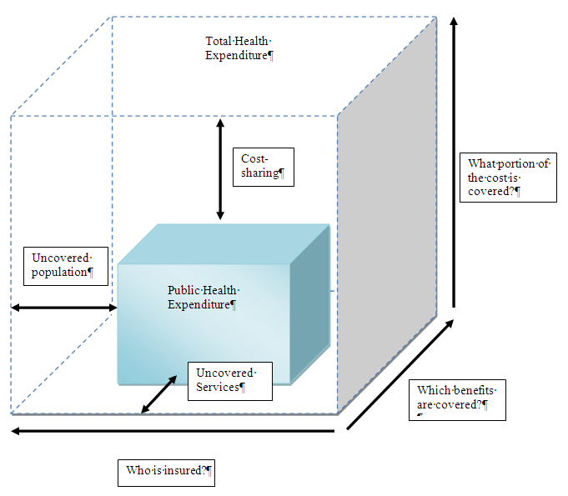
Shift some of the burden to private finance?
While population coverage should not be an option, the boundaries in terms cost-sharing and services are open
Shifting costs to the private (insurance) sector can harbour risks and may not lead to cost-savings
A need to better define and select services covered re. cost-sharing.

Slide 16
Improve the efficiency of the health sector?
Up to a fifth of health spending in OECD countries is at best ineffective and at worst, wasteful:
Adverse events probably occur in one in 10 hospitalisations, adding around 15% to hospital costs
One in three babies is delivered by C-section in OECD, countries when perhaps 15% are medically justified.
Up to 50% of antimicrobial prescriptions are unnecessary.
12% to 56% of emergency department visits are inappropriate.
Share of generics in reimbursed drugs varies between 10% and 80%.
Administrative expenditure on health varies more than six-fold, with no obvious correlation with performance.
Loss to fraud and error may average to 6% of payments for health care services.

Slide 17


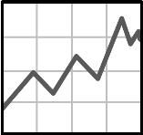

Another trend – increased digitalisation – may be able to increase efficiency
Automation
Robotic tools have led to reductions in complications in standard surgeries
More secure transactions
Several systems using Blockchain technology are being developed
Some ways tech could increase efficiency
More, higher-quality data; better analysis
Wearables mean more data; recently, AI predicted whether breast lesions would turn cancerous 97% of the time
New delivery methods for care
Telemedicine or 3D medicine printing can decrease the cost of access to care
an icon
Notes:
Robots in surgery: https://www.businesslive.co.za/bd/life/2018-01-24-robot-makes-short-work-of-prostate-cancer-surgery/
AI: http://www.bbc.com/news/technology-41651839
Blockchain: https://www.ibm.com/blogs/blockchain/2017/10/blockchain-in-healthcare-patient-benefits-and-more/
Telemedecine: https://www.francetvinfo.fr/sante/politique-de-sante/en-france-la-telemedecine-devient-realite_2574336.html

Slide 18
Some health workforce positions are likely to be automated
Notes:
The three bars in green include the occupations in our sample that touch on healthcare – specifically Health Associate Professionals, Personal Care Workers and Health Professionals. Generally, health occupations are less likely to be automated than the average occupation in our sample.
Source: AUTOMATION, SKILLS USE AND TRAINING (OECD, tbd)

Slide 19
A closer look
Notes:
Health Associate Professionals and Personal Care Workers are about on par with ICT professionals in terms of risk of automation. Health professionals are closer to Teaching Professionals, and thus one of the least likely to be automated, according to OECD analysis.

Slide 20
In conclusion, a little vision of 2070
Less growth, more inequality
More conflict between groups for resources
Ageing, technology, health prices, all driving increased spending on health
Less support for redistribution, public provision
Not obvious how to fund more health spending publicly; private options
Changes in health workforce

Slide 21



Thank you!
Email me
mark.pearson@oecd.org
Follow us on Twitter
@OECD_social
Visit our website
www.oecd.org/health

Slide 22
